Slide 1
City of Coral Gables Biennial Boards and Committees Ethics Training
September 29, 2023

Slide 2
Welcome
9:00-9:15 AM Introduction and Overview of the Role of the City Attorney (Cristina M. Suárez, City Attorney)
9:15- 10:00 AM Miami-Dade County Ethics Code (Robert Thompson, Miami Dade County Commission on Ethics)
10:00- 10:30 AM Public Records & Financial Disclosures (Gustavo Ceballos, Assistant City Attorney & City Prosecutor)
10:30 -11:30 AM Coral Gables Ethics Code, Government in the Sunshine, Quasi-Judicial Proceedings (Cristina M. Suárez, City Attorney)
11:30- 12:00 PM Rules of Procedure (Stephanie Throckmorton, Deputy City Attorney)

Slide 3
Introduction & Overview of the role of the City Attorney
Cristina M. Suárez
City Attorney

Slide 4
Robert Thompson,
Miami-Dade Commission on Ethics and Public Trust

Slide 5

CITY OF CORAL GABLES
Ethics Advisory Board Training
Coral Gables, Florida
September 29, 2023
Miami-Dade Commission on Ethics and Public Trust

Slide 6
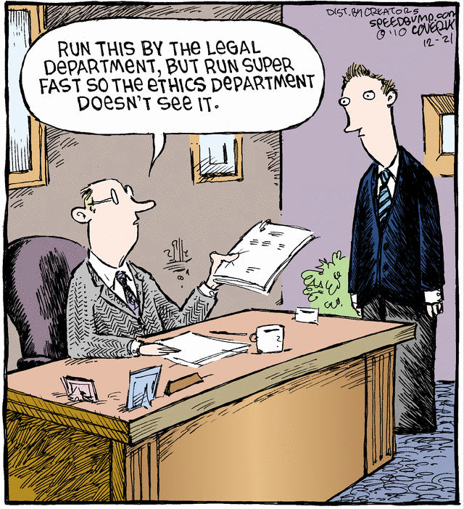

Slide 7
Miami-Dade County
Conflict of Interest and Code of Ethics Ordinance
Section 2-11.1, Code of Miami Dade County

Slide 8
Why the Ethics Commission?
The Miami-Dade County Commission on Ethics and Public Trust is an independent Charter agency of Miami-Dade County, established by vote of the electorate.
It is charged by local law with interpreting and enforcing the County and various municipal Conflict of Interest and Code of Ethics Ordinances.
The Ethics Commission has three main functions:
  At the front end, the Ethics Commission provides training and instruction to elected officials, board members, employees and persons that transact with local government.
  After that, the Ethics Commission provides individualized ethics guidance regarding prospective conduct.
  At the tail end, the Ethics Commission reviews past conduct for potential ethics violations in enforcement actions.

Slide 9
I’m a member of a Coral Gables Board.
What does the County have to do with me?
Sec. 2-11.1. – Miami-Dade County Conflict of Interest and Code of Ethics Ordinance. (January 2016) (a) Designation. This section shall be designated and known as the "Miami-Dade County Conflict of Interest and Code of Ethics Ordinance." This section shall be applicable to all County personnel as defined herein, and shall also constitute a minimum standard of ethical conduct and behavior for all municipal officials and officers, autonomous personnel, quasi-judicial personnel, advisory personnel, departmental personnel and employees of municipalities in the County insofar as their individual relationships with their own municipal governments are concerned. References in the section to County personnel shall therefor be applicable to municipal personnel who serve in comparable capacities to the County personnel referred to.

Slide 10
Why the County Ethics Code?
Sec. 2-11.39.2, County Code
Application of the Miami-Dade County Conflict of Interest and Code of Ethics Ordinance:
The provisions of the Miami-Dade County Conflict of Interest and Code of Ethics Ordinance shall be applicable to county boards.

Slide 11
“Advisory Personnel”
Section 2-11.1.(b)(4), Code of Ethics
The County Ethics Code shall apply to County personnel as defined:
Advisory Personnel are defined as members of those County Boards whose primary responsibility is to recommend legislation, policy or give advice to the Board of County Commissioners.

Slide 12
Practice Tip & Preferences:
Please ask before you act
The Ethics Commission can only provide ethics guidance prospectively, meaning regarding future or ongoing transactions. Past actions are handled as potential enforcement matters.
As regards board members, some board members reach out directly, some with or through staff, some with or through the County Attorney or municipal attorneys, and some never directly and only through counsel. All manner is appropriate and welcomed.
Staff will have to confirm accuracy of transaction fact patterns prior to the issuance of the opinion.
As a courtesy, we will let you know what the opinion is before it issues as a numbered and published INQ. This is the only way opinions issue.
If the issue is novel, the opinion will be presented to the Ethics Commission in open session and the requester will be invited to participate.

Slide 13

The Code of Ethics:
Administered and Interpreted by the Commission on Ethics & the State Attorney’s Office has Concurrent Jurisdiction
The State Attorney’s Office (SAO) has concurrent jurisdiction over all the provisions of the Conflict of Interest and Code of Ethics Ordinance.
If any of these provisions are prosecuted by the SAO they are classified as 2nd degree misdemeanors and are punishable by a $500 fine and/or 30 days imprisonment or both.

Slide 14
Gifts

Slide 15

A public employee or board member may never solicit or accept a gift if there is a nexus between the gifting transaction and the employee’s or member’s public charge.

Slide 16

Four Basic Rules:
Easy to Follow
You may never solicit a gift if there is a nexus to your public position.
You may never accept a gift if there is a nexus to your public position.
You may never accept a gift from certain parties.
You may accept gifts from friends and families unrelated to your public position, but you may have to report them.

Slide 17
Gifts
Miami -Dade Ethics Code Sec. 2-11.1(e)
A gift is anything of economic value offered or given without adequate and lawful consideration.
A gift may take the form of money, services, loans, travel expenses, entertainment or hospitality expenses.
The major exceptions will include: 1) Political contributions; 2) Gifts from relatives or household members; 3) Professional or civic awards; 4) Materials of an informative or advertising nature; and 5) charitable donations.

Slide 18

Prohibited Gifts
Miami-Dade Ethics Code Sec. 2-11.1(e)(3)
“[Public officials, employees, and board members] shall neither solicit nor demand any gift.” Sec.2-11.1.1(e)(3)
No elected official, employee, or board member may accept any gift for or because of:
  An official public action taken or to be taken, or which could be taken;
  A legal duty performed or to be performed, or which could be performed; or
  A legal duty violated or to be violated, or which could be violated by any elected official.
It is also a violation to offer the gift in exchange for the above.

Slide 19
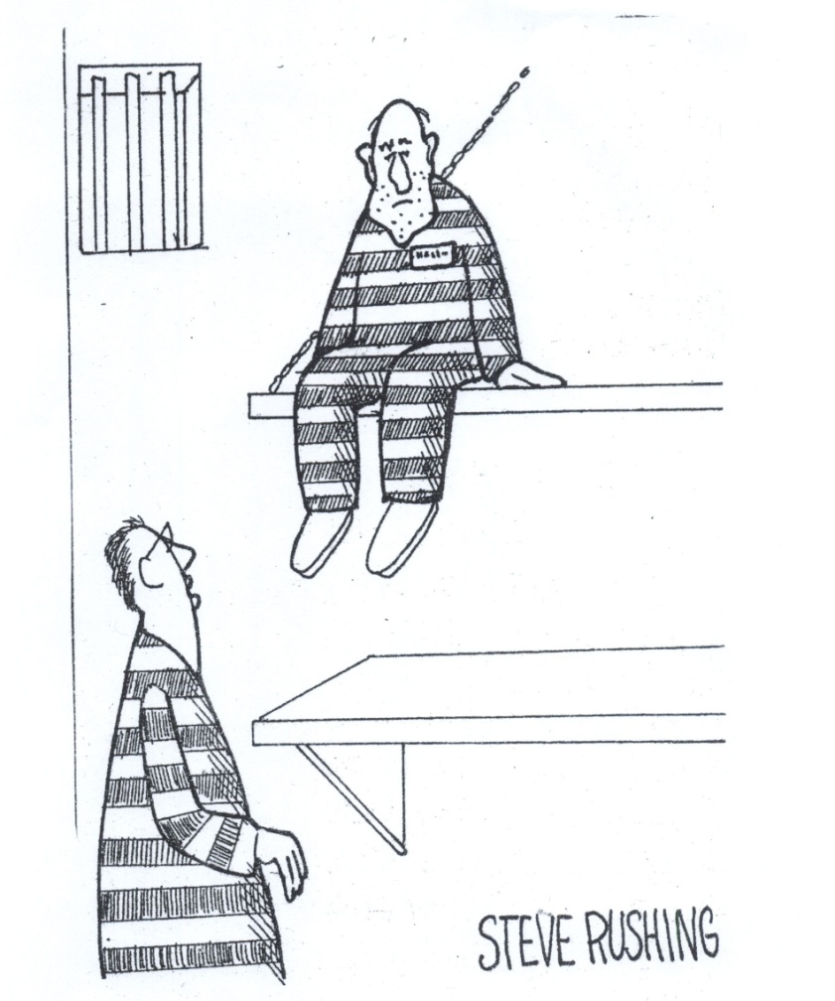
I knew it was unethical, but I didn’t know it was illegal, too.

Slide 20
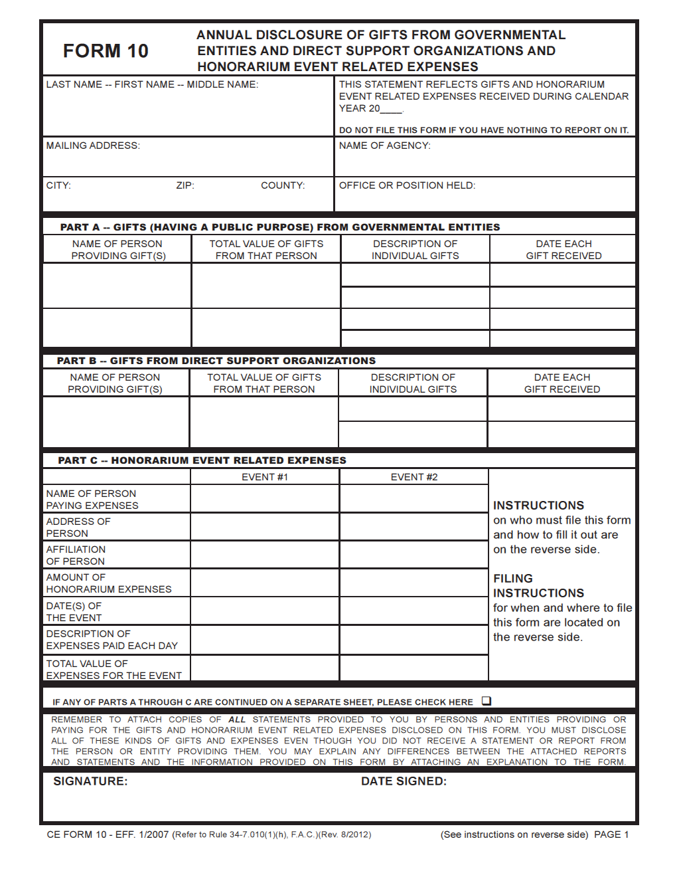
Gifts Disclosure
Miami -Dade Ethics Code Sec. 2-11.1(e)(4)
What gifts must be disclosed?
  Any board member receiving a gift in
  excess of $100 must report it by filing a gift disclosure form.
How must a gift be disclosed?
This disclosure shall be made by filing a copy of the disclosure form required by Chapter 112, Florida Statutes, for “local officers” with the Florida Secretary of State.
When must the gift disclosure be filed?
No later than July 1 of each year for the preceding calendar year ending December 31.
Quarterly (3/31, 6/30, 9/30, 12/31)

Slide 21
Exploitation of Official Position

Slide 22
Exploitation of Official Position Prohibited
Miami-Dade Ethics Code Section 2-11.1(g)
No board member shall use or attempt to use his or her official position to secure a special benefit or privilege for himself or herself or others.

Slide 23
Confidential Information
Sec. 2-11.1 (h), County Ethics Code
Advisory board members may not:
  accept employment or engage in any business or professional activity that they might reasonably expect would induce them to disclose confidential information acquired by reason of their official position;
  disclose confidential information obtained through their official position with the County; or
  use such information, directly or indirectly, for personal gain or benefit.

Slide 24
Official Action Directly or Indirectly Affecting a Business in Which Official or Family Member Has a Financial Interest
Miami-Dade Ethics Code, Sec. 2-11.1(n)
No board member may: Participate in any official action that may directly or indirectly affect a business in which the member or his or her family member has a financial interest.

Slide 25
Financial Conflicts of Interest

Slide 26

The financial conflict of interest provisions are like peeling back layer, after layer of an onion.

Slide 27


So, pause and another
“Four” to remember
You may be prohibited from transacting with the County, individually.
You may be prohibited from transacting with the County, through a company.
Your immediate family member may be prohibited from transacting with the County, individually.
Your immediate family member may be prohibited from transacting with the County, through a company.
Pause and ask for guidance

Slide 28
Prohibition on Transacting Business with Local Government
Miami-Dade Ethics Code 2-11.1(c)(1) and (d)
  Board members and their immediate family members are prohibited from entering a contract or transacting any business with their municipality in which the elected official or his or her immediate family has a financial interest, direct or indirect, unless waived by governing board.
  Immediate family members: spouse, domestic partner, parents, stepparents, children, stepchildren and siblings.
  Transaction or contract is voidable.
  Willful violation constitutes malfeasance – and may lead to forfeiture of office/position.

Slide 29
Limited Exception for Board Members
Sec. 2-11.1(c)(3), Ethics Code
Board members, their families, individually or through firms may be able to transact or contract with the County but not if the contracting department or agency is subject to regulation, oversight, management, policy setting, or authority of the board on which the person is a member.

Slide 30
Prohibited Investments
Miami-Dade Ethics Code, Sec. 2-11.1 (l)
No local board member or immediate family member shall have personal investments in any enterprise, either himself, herself or through a member of his or her immediate family, which will create a substantial conflict between his or her private interests and the public interest.

Slide 31

Acquiring financial interest
Miami-Dade Ethics Code, Sec. 2-11(o)
No board member shall acquire a financial interest in a project, business entity or property at a time when he or she believes or has reason to believe that the said financial interest will be directly affected by his or her official actions or by official actions by the municipality of which he or she is an official, officer, employee or contract staff.

Slide 32
Prohibition on Recommending Professional Services
Miami-Dade Ethics Code, Sec. 2-11.1(p)
  No board member may recommend the services of any lawyer or law firm, architect or architectural firm, public relations firm, or any other person or firm, professional or otherwise to assist in any transaction involving the municipality or any of its agencies.
  Such recommendation may be properly made:
    1) when required to be made by the duties of office, and
    2) when noticed in advance at a public meeting attended
    by other municipal officials, officers, or employees.

Slide 33
Compulsory Disclosure
Miami-Dade Ethics Code, Section 2-11.1(f)
Any board member whose immediate family member is employed or has a financial interest in a firm or business entity that has substantial business commitments to or from the County or any County agency or is subject to direct regulation by the County or a County agency, must file a sworn statement disclosing the employment with the Clerk of the Board.

Slide 34
Outside Employment

Slide 35

Prohibition on Conflicting Employment
Miami-Dade Ethics Code, Sec. 2-11.1(j)
No advisory board member may:
  Accept other employment;
  Which would impair his or her independence of judgment;
  In the performance of his or her public duties.

Slide 36
Certain Appearances and Payment Prohibited
Miami-Dade Ethics Code, Sec. 2-11.1(m)
No local government elected official, or employee may:
Appear before their municipal board or agency and make a presentation on behalf of a third person with respect to any decision, or benefit sought by the third person.
Receive compensation, directly or indirectly, for services rendered to a third person in connection with some benefit sought by the third person.
Appear in any court or before any administrative tribunal as counsel or legal advisor to a party seeking legal relief from the municipality.

Slide 37
Voting Conflicts

Slide 38

Voting Conflicts
Sec. 2-11.1 (v), County Ethics Code
Advisory board members may not vote on any matter if the member will be directly affected by the board action and the board member has any of the following relationships with the persons or entities appearing before the board:
  Officer, partner, consultant, fiduciary, stockholder, debtor, director, of counsel, employee, beneficiary, bondholder, creditor.

Slide 39

Voting Conflicts
Best advice on what you should do:
Announce your conflict publicly in advance.
Absent yourself from the room.
File disclosure (State Form 8B) with
your board liaison.

Slide 40

Remember: You Gotta Vote even if you are grumpy.
Section 286.012, Florida Statutes
A member of a state, county, or municipal governmental board, commission, or agency who is present at a meeting of any such body at which an official decision, ruling, or other official act is to be taken or adopted may not abstain unless there is a possible conflict of interest.

Slide 41
Cone of Silence

Slide 42


Slide 43
Cone of Silence
Ethics Code Section 2-11.1(t)
The County Cone of Silence provides for a period in almost every competitive selection process during which restricts communications between designated individuals in the procurement process regarding an advertised bid, RFP or RFQ. The Cone commences after the advertisement of the RFP or RFQ and terminates upon the upon the recommendation to the elected body.

Slide 44
Cone of Silence: Purpose
The purpose of the Cone of Silence is to limit the influence of elected officials, private contractors and lobbyists on the procurement process.

Slide 45


Penalty provisions
Violators subject to an admonition, letter of instruction or public reprimand and/or
($500.00) fine for the first such violation;
($1,000.00) fine for each subsequent violation;
Fines double for intentional violations.

Slide 46

Lobbying

Slide 47

Lobbying
Section 2-11.1(s), Miami-Dade Code
Who is a lobbyist?
  Person, firm or corporation employed by principal (paid or unpaid) who seeks passage, defeat or modification of:
    Ordinance, resolution, action/decision of Municipal Commission or Council,
    Action/decision/recommendation of the Municipal Mayor/Manager or any Municipal board or committee,
    Action/decision/recommendation of Municipal personnel during the entire decision-making process leading to a decision by any Municipal board or committee
Includes principal, i.e., owner or representative of company, who lobbies.
All lobbyists shall register before engaging in lobbying activity.

Slide 48
Practice Tip
Best practice is set up a standard process for Board Members or staff when meeting with someone who is or may be a proposer, vendor, or proposer/vendor representative.
  In some local governments all contacts are preceded by the visiting party having to identify themselves in writing, who they represent, the nature of their contact and whether they are registered as a lobbyist for any other entity.

Slide 49
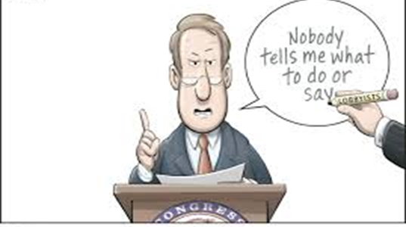
But I’m not a lobbyist, why should I care?
You should be diligent to ascertain whether persons required to register pursuant to this section have complied.
Officials may not knowingly permit a person who is not registered to lobby him/her.

Slide 50
Citizens’ Bill of Rights

Slide 51

Citizens’ Bill of Rights
Miami-Dade Home Rule Charter, May 1957
Commission on Ethics empowered to review, interpret and render advisory opinions regarding Citizens’ Bill of Rights (Section 2-1072, Miami-Dade County Code since 1997)
Commission on Ethics given authority to enforce Citizens’ Bill of Rights and impose penalties set out in Section 2-11.1(cc)(1) of Miami-Dade County Code of Ethics Ordinance (2012 Referendum).

Slide 52
Guarantees All Citizens:
Prompt and convenient service from local government;
Truthful information from public servants.
Right to inspect and copy public records.
Proper notice of and opportunity to participate in public meetings.
Transparency in budgeting and auditing.

Slide 53
Public Record
2016 Miami-Dade County Referendum
All audits, reports, minutes, documents and other public records of the county and the municipalities and their boards, agencies, departments and authorities shall be open for inspection and copying, consistent with the requirements of the State of Florida’s public records laws at reasonable times and places convenient to the public.

Slide 54

On behalf of the Commission on Ethics
Dr. Judith Bernier, Chair
Wifredo “Willie” Gort, Vice-Chair
Nelson C. Bellido, Esq.
Dava J. Tunis, Esq.
Lourdes Fernandez, Esq.
Jose Arrojo, Executive Director
Thank you for your attention

Slide 55

All Done

Slide 56
Public Records
Gustavo Ceballos,
Assistant City Attorney &
City Prosecutor

Slide 57
Florida Public Records Law

Slide 58
What is a public record?
All materials made or received by an agency in connection with the transaction of official business which are used to perpetuate, communicate or formalize knowledge. Shevin v. Byron, Harless, Schaffer, Reid and Associates, Inc., 379 So. 2d 633, 640 (Fla. 1980).
Documents, papers, letters, maps, books, tapes etc. regardless of the physical form.
  Includes digital documents, emails (AGO 96-34 and 01-20), electronic calendars and even certain text messages.
The record should be produced in the format that it is maintained.
You do not need to create a record, in response to a request, if one does not exist.

Slide 59
What is a public record?
Drafts shared for comment?
Notes to self?
  Personal notes can be public records if they are intended to communicate, perpetuate or formalize knowledge of some type. See, Miami Herald Media Company v. Sarnoff, 971 So. 2d 915 (Fla. 3d DCA 2007)
  However, public employees’ notes to self-designed for own use in remembering certain items, are not public records. Justice Coalition v. The First District Court of Appeal Judicial Nominating Commission, 823 So. 2d 247 (Fla. 1st DCA 2002)
  See also, Op. Att’y Gen. Fla 10-55 (2010), notes not public records if not transcribed or shown to others.

Slide 60
What is a Public Record?
Electronic Records
  E-mail messages made or received in connection with official business
  Placement of material on a city’s Facebook page may be a public record (Op. Att’y Gen. Fla. 09-19 (2009) and Op. Att’y Gen. Fla. 08-07 (2008)).
  Text messages
    Inf. Op. to Browning, March 17, 2010- retention required depending on context of text messages.
  Elected official’s twitter account. List of accounts blocked from accessing an officials’ twitter could be a public record if the tweets are public records. Inf. Op. to Shalley, June 1, 2016.

Slide 61
Access to Government Records
“Every person has the right to inspect or copy any public record made or received in connection with the official business of any public body, officer or employee of a municipality”- Florida Constitution Section 24(a)
“Every person who has custody of the public record shall permit the record to be inspected and copied by any person desiring to do so, at any reasonable time, under reasonable conditions and under supervision by the custodian of the public records” – Section 119.07(1)(a), F.S.

Slide 62
Who can request public records?
“person” includes individuals, firms, associates, joint ventures, partnerships, estate trusts, corporations and all other groups or combinations, regardless of whether the “person” is a citizen of the State of Florida.
Requests can be made anonymously.
It is not mandatory that public records requests be made in writing.
The motivations of the person making a public records request are not relevant.

Slide 63
Response Time
Prompt Response: Acknowledgment of a request to inspect or copy a public record must be made promptly and in good faith.
  Section 119.07(1)(c), F.S.
Reasonable Right of Access: The time it takes to locate a record, review it for exempt information, and provide a copy to the requestor.
  Section 119.07(1)(a) F.S.; Tribune Co. v. Cannella, 458 So.2d 1075, 1078 (Fla. 1984).

Slide 64
Fees
As a general rule, there is no fee for the mere inspection of a public record and fees for providing copies of public records must be statutorily authorized. The custodian of the public records must furnish a copy of a requested record upon payment of the fee prescribed by law. If there is no statutorily prescribed fee, the record custodian can charge no more than 15 cents a page for paper copies.

Slide 65
Extensive Use Fees
If a request for records requires an “extensive use” of agency resources, whether personnel or information technology or both, an agency may charge a special service charge in addition to the per-copy charge or the actual cost of duplication.
An extensive use fee must be reasonable and based on actual costs incurred, it cannot be automatically applied.
Local agencies have a great deal of flexibility in assessment of fees.
In 2021 the City Commission adopted an updated Public Records and information request policy setting fees for extensive use requests, those requests taking over 30 minutes of staff time.

Slide 66
Coral Gables Public Record and Information Request policy
Resolution 2021-220, adopted by the City Commission:
  Defines extensive use and information requests, and sets out all applicable fees and procedures.
Many documents are available to the public on the City’s website, including all resolutions and ordinances, meeting minutes etc.
Police and Fire have separate procedures for record requests.
Forward any public record requests that may be sent to you, to your staff liaison.

Slide 67
Exemptions
Exemptions, set by Florida Statutes
  Examples: Social Security Numbers, Law Enforcement Officer addresses, Bank Account Numbers, Security System information.
Confidential and Exempt v. Exempt Information
  Agency may release exempt information but not information that is confidential and exempt except when specified by the exemption.
Email addresses are never exempt from disclosure.
Are you a protected person?

Slide 68
Sanctions
A knowing violation of Ch.119, F.S., is a 1st degree misdemeanor punishable by a fine up to $1,000 and a jail term not exceeding one year. (Sec. 119(1)(b) and (2)(a), F.S.)
An unintentional violation of public records laws is a non-criminal infraction punishable by a fine not exceeding $500.
Those who have intentionally violated the law can be suspended or removed from office. (Sec. 112.52(1), F.S.)
An agency that has been found to have violated the law- whether an intentional or unintentional violation will be required to pay attorney fees and court costs. (Sec. 119.12, F.S)

Slide 69
Your Public Records
Emails you send and receive related to City Business.
Reports and documents you send and receive in your capacity as a Board and Committee member.
If you are communicating about the official business of your Board or Committee, or items that could conceivably come before your Board or Committee, those are public records even if they are sent or received from your private email address or cell phone.
  Please cc or forward all emails to your City staff liaison so they will be properly retained.
Requests for your records.
Your responsibility to maintain records on your private devices.

Slide 70
Requesting Records For Your Board or Committee
Reasonable requests for information and documents can be made by the Chair and board members within the jurisdiction of their board/committee.
Requests should be made at a meeting or by email and relate to a board/committee agenda item.
Requests should be made to the staff liaison with copies to the City Clerk and City Attorney’s office.
If there is disagreement about the request, such as scope or jurisdiction, request would be brought to the full board and the City Attorney’s office would serve as parliamentarian.
This is a separate process from the public record process which would apply to requests made in an individual capacity
CAO 2017-39.

Slide 71
Financial Disclosures
Gustavo Ceballos,
Assistant City Attorney &
City Prosecutor

Slide 72
Financial Disclosure

Slide 73
Who has to file?
“Autonomous personnel” members of semi-autonomous boards entrusted with day-to-day policy setting operation and management of certain defined City functions. (I.e. retirement board)
“Quasi-judicial personnel” members of boards that perform quasi-judicial functions. (I.e. encroachment committee, planning and zoning board, board of adjustment and code enforcement board)
“Advisory personnel” – members of City advisory boards whose responsibility is to recommend legislation or give advice to the City Commission. (I.e. landscape beautification advisory board, library advisory board, traffic advisor board and parks and recreation advisory board)

Slide 74
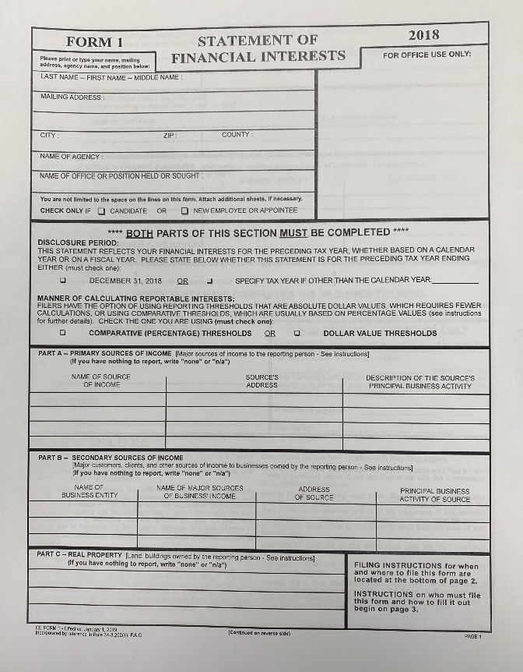
What needs to be filed?
State of Florida - “Form 1 - Statement of Financial Interest”
  Board Members (F.S. 112.3144 & 112.3145)
  Ex: Board of Adjustment, Historic Preservation Board, Planning and Zoning Board, Pension Board, Construction Regulation Board, & Code Enforcement Board.
  Form may be obtained at City Clerk’s Office or from your board liaison.

Slide 75
What needs to be filed?
Miami-Dade County – “Source of Income Statement”
  Advisory Board members and those not required to file Form 1
  Form may be obtained at City Clerk’s Office
  Alternatively a copy of tax returns or a
  financial statement on form approved by
  State or national banks can be filed.

Slide 76
When & Where do I
need to file?
City Clerk’s Office
By 12 noon on July 1st of each year including the July 1st following the last year that person served on board/committee.
Disclosure due July 1st is for preceding calendar year (i.e. 7/1/24 – statement for 2023).

Slide 77
Coral Gables Ethics Code,
Government in the Sunshine, Quasi-Judicial Proceedings
Cristina M. Suárez, City Attorney

Slide 78
City of Coral Gables
Ethics Code

Slide 79
Prohibited Investments
Sec. 2-11.1(L), Miami-Dade Code
Sec. 2-294, Coral Gables Code
No elected official, employee, or board member shall have investments, either personally or through an immediate family member, which will create a “substantial conflict” between his/her private interests and the public interest.

Slide 80
Who is “Immediate Family?”
County – spouse, domestic partner, parents, stepparents, siblings, half-siblings, step-siblings, children and stepchildren.
(Sec. 2-11.1(b)(9), Miami-Dade Code)
City – spouse, parents, children, brothers and sisters registered domestic partner, stepparents, stepchildren, uncle, aunt, in-laws - City adds in-laws (including both parents and siblings) (Sec. 2-286, Coral Gables Code)

Slide 81
Gifts
Sec. 2-11.1(e), Miami-Dade Code
Sec. 2-289, Coral Gables Code
It is unlawful to solicit or demand a gift in exchange for an official duty or public action.
“Gift” is anything of economic value, including: meals, travel, loans, entertainment, hospitality, or a promise of such, without adequate consideration.
Difference in market value & discounted price (if not part of larger discount program) = gift
Note: Under State law, may not accept a gift from a lobbyist over $100.

Slide 82
What is not a gift?
Sec. 2-11.1(e), Miami-Dade Code
Sec. 2-289(b), Coral Gables Code
City & County:
  Political contributions;
  Awards for civic or professional achievement (i.e. plaque, shovel);
  Informational books/pamphlets;
  Gifts from relatives or member of one’s household

Slide 83
Gift Disclosure
Sec. 2-11.1(e)(4), Miami-Dade Code
Sec. 2-289(d), Coral Gables Code
Who?
  Board members
  (Also includes employees and elected officials.)
What?
  County Quarterly Gift Disclosure form
When?
  End of the quarter following the quarter in which the gift was made (i.e. gift(s) received Jan-Mar must be reported by the end of June). *Note: series of gifts from same individual/entity which total exceeds $100 in a quarter = disclosure
Where?
  City Clerk’s Office (may be filed through the board liaison)

Slide 84
Exploitation of Official Position
Sec. 2-11.1(g), Miami-Dade Code
Sec. 2-290, Coral Gables Code
No elected official, employee or board member may use or attempt to use his/her official position to secure special privileges or exemptions for him/herself or others.
Same as County Code.
Examples (from previous COE complaints)
  North Miami Commissioner – exerting influence to get upgrades to mother’s home which was part of city’s grant program.
  Miami Commissioner – calling Chief of Police during traffic stop.
  North Miami Commissioner – using city soccer field for his league without paying for use.
  NMB Commissioner– interfering with Code Enforcement by yelling at officer not to go by his home again.
  South Miami – endorsing fellow commissioner while on dais during televised meeting.
  El Portal Mayor – asked Code Enforcement officer to use his personal truck to move a donated piano to her daycare

Slide 85
Confidential Information
Sec. 2-11.1(h), Miami-Dade Code
Sec. 2-291, Coral Gables Code
Elected officials, employees and board members may not:
  accept employment or engage in any business or professional activity that they might reasonably expect would induce them to disclose confidential information acquired by reason of their official position;
  disclose confidential information gained through their official position with the City; or
  use such information, directly or indirectly, for personal gain or benefit.
  Same as County Code.
Notes:
Rarely comes up because of public records laws. Caution after executive session for union/labor negotiations.

Slide 86
Appearances
Sec. 2-11.1(m)(2), Miami-Dade Code
Sec. 2-295, Coral Gables Code
Elected officials, employees, and board members may not:
  appear before any municipal board or agency (includes City employees) on behalf of 3rd parties seeking a benefit; or
  receive compensation for services rendered, directly or indirectly, from 3rd party who has applied for or is seeking a benefit from the municipality.
County - Board members may not appear before their own board but may appear before other municipal boards.
City – Board members may not appear before their own board or before the City Commission.
Both allow architects, in certain circumstances.
City adds – Board members may not, after deliberating, considering or ruling on an application, appear before a higher board to testify as an affected party. Exception: Chair may appear before City Commission to provide board’s recommendation.

Slide 87
Actions Prohibited when Financial Interests Involved
Sec. 2-11.1(n), Miami-Dade Code
Sec. 2-296, Coral Gables Code
Elected officials, employees, and board members shall not participate in any official action directly or indirectly affecting a business in which he/she or any member of his/her immediate family has a financial interest.
Financial interest may be direct or indirect.
Financial interest may be direct or indirect

Slide 88
Lobbyists (City)
Sec. 2-305,Coral Gables Code
Definition:
  Individual, firm, corporation, partnership, firm
  Employed or retained (paid or unpaid),
  By a principal,
  Who seeks to encourage the passage, defeat or modification of:
  to governmental actions (i.e. ordinances, resolutions, rules, regulations, executive orders, procurement actions, decision of the City Commission, the mayor, any City board/committee, or city personnel.)
  During time period of decision-making process.
  Specifically includes “principal” as lobbyist.
  Encompasses all forms of communication.

Slide 89
Lobbyists (City) Cont.
Excludes:
Representatives of governmental entities;
Person who appears on behalf of homeowner’s association without compensation/reimbursement;
Expert witnesses providing testimony at a public meeting;
Persons requested to appear in quasi-judicial proceedings;
Vendor who communicates regarding performance of their contract;
Foreign dignitaries;
Individuals appearing for purpose of self-representation;
Attorneys during quasi-judicial proceedings;
Person employed by principal whose normal scope of employment does not include lobbying and who is not engaged in lobbying on behalf of principal;
Persons engaged in a list of activities regarding a procurement matter.

Slide 90
Lobbyist Registration
Sec. 2-305(b), Coral Gables Code
Must register and pay annual fee (may be waived on finding of financial hardship).
Must state, under oath, name and contact information of lobbyist, name and contact information of principal, specific issue, existence of any business association or financial relationship with any employee of the City.
Notice of withdrawal required if lobbyist wishes to withdraw.
Must complete lobbyist training within 60 days of registration (as of August 2021)
  All members of the commission and personnel shall be diligent to ascertain whether persons required to register have complied and adds that a commissioner and/or personnel may not knowingly permit a person who is not registered to lobby. The diligence requirement may be satisfied by maintaining a written log.
Must announce, on the record, that he/she is a registered lobbyists when presenting before the City Commission or a board/committee

Slide 91
Conflicting Employment
Sec. 2-292, Coral Gables Code
    Applies to elected officials, appointed officials and employees.
No elected official or employee shall:
  accept other employment
  which would impair his/her independence of judgment
  in the performance of his/her public duties.
  Same as County Code.

Slide 92
Government in the
Sunshine Law

Slide 93
Authority
Art. 1, Sec. 24, Florida Constitution
  All meetings of any collegial body of any…municipality…at which official acts are to be taken or at which public business of such body is to be transacted or discussed, shall be open and noticed to the public.
Sec. 286.011, F.S.
  All meetings of any board or commission of any…municipal corporation…at which official acts are to be taken are declared to be public meetings open to the public at all times, and no resolution, rule or formal action shall be considered binding except as taken at such meeting.
  The board or commission must provide reasonable notice of all such meetings.
  Minutes of a meeting of any such board or commission shall be promptly recorded and such records shall be open to public inspection.

Slide 94
Three basic requirements for public meetings
1. Must be open to the public;
2. Reasonable notice of such meetings must be given;
3. Minutes of the meeting must be taken.

Slide 95
Open to the public
Accommodations:
Public boards should take reasonable steps to ensure that the location where the meeting is held will accommodate for the expected turnout.
Facility must be kept open and accessible.
Communication:
A violation may occur if, during a meeting, board members are speaking to each other about the item, in a manner not audible to the public and outside of the record.
A violation may occur if, during a recess of a public meeting, board members discuss issues before the board.
Phone meetings:
Not permitted unless there is a physical quorum in the room when extraordinary circumstances exist.
Inspection Trips:
Advisory board members permitted to go on inspection trips provided that board members do not discuss a matter that may go before their board but this does not apply to boards with “ultimate decision-making authority.” Safest course of action is to visit the site separately so as to avoid an inadvertent violation.

Slide 96
Notice Requirement
“Reasonable notice” required – what is reasonable depends on facts and board involved.
Notice should contain time and place and general subjects to be discussed or agenda, if available.
Should be posted in designated public area and on webpage.
For matters of great public importance, consider providing notice in newspaper of general circulation.

Slide 97
Minutes
The use of the term "minutes" in Section 286.011, F.S., contemplates a brief summary or series of brief notes or memoranda reflecting the events of the meeting.
  AGO 82-47.
An agency is not prohibited from using a written transcript of the meeting as the minutes, if it chooses to do so.
  Inf. Op. to Fulwider, June 14, 1993.
Board meetings may be recorded but minutes must still be taken.
- AGO 75-45
“Promptly recorded and open to public inspection” means “its plain and ordinary course.”
- Inf. Op. to Board of Trustees, January 27, 2009
Minutes are public record when the person responsible for preparing the minutes has performed the duty even if not officially approved by the board.
- AGO 91-26

Slide 98
What Government bodies are covered?
“any board or commission of any state agency or authority or of any agency or authority of any county, municipal corporation, or political subdivision”
equally applicable to elected and appointed boards or commissions

Slide 99
What is a meeting?
Sunshine Law extends to the discussions and deliberations as well as formal action taken by a public board.
There is no requirement that a quorum be present for a meeting of members of a public board to be subject to section 286.011. The law is applicable to any gathering, whether formal or casual, of two or more members of the same board to discuss some matter on which foreseeable action will be taken by the public board.
  Hough v. Stembridge, 278 So. 2d 288 (Fla. 3d DCA 1973).
The term “meeting” extends to e-mail correspondence, as well as meetings conducted over electronic media, such as Facebook, if the exchange or discussion concerns matters that foreseeably will come before the board for official action
  State v. Childers, No. 02-21939-MMC; 02-21940-MMB; AGO 09-19
If a board delegates its decision-making authority to a single individual, or a non-board member is being used as a liaison between or to conduct a de facto meeting of board members, the Sunshine Law may apply.

Slide 100
Written Correspondence Between Board Members
A board member may send a written report to other board member on a subject that will be discussed at a public meeting without violating the Sunshine Law if:
1.) prior to the meeting there is no interaction related to the report among the commissioners and;
2.) the receiving board member does not respond.
Best practice is not to do so; only use when necessary.

Slide 101
E-mail Correspondence
E-mail communication of factual background information from one council member to another is a public record but does not constitute a meeting subject to the Sunshine Law when it does not result in the exchange of council members' comments or responses on subjects requiring council action.
  AGO 01-20
Exception: If the report is circulated among board members for comments with such comments being provided to other members, there is interaction among the board members which is subject to Section 286.011. (ie., do not “reply all”).
  AGO 90-03
Best course of action: If you wish to distribute information to fellow board members, send it to the staff liaison who can then share it with the Board members.

Slide 102
Penalties & Sanctions
Criminal Violation: Any member of a board or commission or of any state agency or authority of a county, municipal corporation, or political subdivision who knowingly violates the Sunshine Law is guilty of a misdemeanor of the second degree. Section 286.011(3)(b), F.S.
Non- Criminal Violation: any public officer violating the provisions of the Sunshine Law that is guilty of a noncriminal infraction, is punishable by a fine not exceeding $500.
Section 286.011(3)(a), F.S.

Slide 103
Quasi-Judicial
v.
Legislative
Hearings

Slide 104
Quasi-Judicial Boards
Historic Preservation Board
Construction Regulation Board
Code Enforcement Board
Board of Architects
Board of Adjustment
Planning & Zoning Board

Slide 105
Test to Determine whether board is sitting in a quasi-judicial capacity
“It is the character of the hearing that determines
whether or not board action is legislative or quasi-
judicial…Generally speaking legislative action
results in the formulation of a general rule of
policy, whereas judicial action results in the
application of a general rule”
Snyder v. Bd. of County Commissioners, 627 So. 2d 469 (Fla. 1993).

Slide 106
Quasi-Judicial Proceedings
Decisions that:
(1) have an impact on a limited number of persons
or property owners,
(2) when the decision is contingent on a set of facts,
(3) where the decision can be viewed as the
application of policy, rather than setting policy.
Ex: rezoning, site plan approval, variance.
Decision must be based on competent substantial
evidence.

Slide 107
Requirements of Quasi-Judicial Proceedings
*Board is sitting like a judge.
(Must also consider whether you can be “fair and
impartial.”)
Parties must be provided with:
1.) notice of the hearing.
2.) an opportunity to be heard, and
3.) when involving zoning, the parties must be able to present evidence, cross-examine witnesses, and be informed of all facts upon which the quasi-judicial body acts.
4.) Ex-parte communications are prohibited.

Slide 108
What is an Ex-Parte Communication?
A communication between a Commissioner (outside of a public hearing) and one of the parties.
Creates a presumption of prejudice.
Possible types of ex parte communications:
Written Information: including letters, faxes and e-mail.
Oral Communications: telephone calls and private meetings.

Slide 109
Inadvertent Ex-Parte Communications
How to cure:
The complete substance of what was presented at the ex-parte meeting should be disclosed at the public hearing.
Any written ex-parte communication should be made part of the record on the item.
If a party then expresses concern that it has been prejudiced by the ex-parte communication, the party should be allowed time to respond to the information.

Slide 110
What is not a prohibited ex-parte communication?
City staff, such as planners, engineers, and other experts, may meet with quasi-judicial officers to advise them of their professional opinions regarding quasi-judicial applications.
As long as the staff members are not attempting to influence the decision maker and the communications.

Slide 111
Rules of Procedure
Stephanie Throckmorton,
Deputy City Attorney

Slide 112
Rules of Procedure
Robert’s Rules of Order

Slide 113
Robert’s Rules of Order, Newly Revised
To the extent not in conflict with the City Code, rules adopted by the board, or applicable state law, each board shall adhere to Robert’s Rules of Order, Newly Revised. City Code Secs. 2-55(a), 2-77(a)(1).
  Questions of order
  Methods of organization
  Conduct of business

Slide 114
Parliamentarian
The City Attorney shall serve as parliamentarian and shall advise and assist the chairperson in matters of parliamentary law. In the absence of a rule of procedure, the parliamentarian shall refer to Robert’s Rules of Order, Revised, on all rulings. City Code Sec. 2-80.

Slide 115
Quorum
What is a quorum?
  The minimum number of members who must be present at meetings of a deliberative assembly for business to be validly transacted. RONR (11th ed.), p. 21.

Slide 116
Quorum
General Rule: A quorum for all boards’ meetings shall consist of a majority of the board’s total membership. City Code Sec. 2-55(b).
  Example: If a board has five (5) members, three (3) members must be present to constitute a quorum.
Exception: Those boards whose creating resolution or ordinance provides for a different quorum.
  E.g. Sustainability Advisory Board; Board of Architects

Slide 117
Quorum
General Rule Regarding Required Vote
  The decision of a majority of the board members present and voting at a meeting at which a quorum is present shall be the decision of the board. City Code Sec. 2-55(b).
    Example: If a board has five (5) members and three (3) members are present, there is a quorum and the decision of two (2) members present shall be the decision of the board.

Slide 118
Quorum
Exceptions Regarding Required Vote
  Historic Preservation Board, Zoning Code Sec. 14-105.3(B)(HPB is a nine (9) member board, so five (5) members constitute a quorum. Adoption of any motion requires the affirmative vote of a majority of the full Board.)
  Planning and Zoning Board, Zoning Code Sec. 14-102.3(B) (P&Z is a seven (7) member board, so four (4) members constitute a quorum. The affirmative vote of four (4) members of the Board shall be necessary for the adoption of any motion.)
  Board of Adjustment, Zoning Code Sec. 14-104.3(B) (BOA is a seven (7) member board, so four (4) members constitute a quorum. The affirmative vote of four (4) members of the Board present shall be necessary to authorize a variance or grant an appeal.)

Slide 119
Conduct of Business
Open to the Public: All meetings of boards and committees shall be open to the public in accordance with Florida’s Sunshine Law. City Code Sec. 2-77(2).
Official Agenda: There shall be an official agenda for every meeting which shall determine the order of business conducted at the meeting. City Code Sec. 2-79(a).

Slide 120
Conduct of Business
Chairperson
  Each board and committee shall meet annually to elect one of their members as a chairperson and one as a vice-chairperson. City Code Sec. 2-55(a).
  The chairperson presides at all meetings of the board or committee. City Code Sec. 2-78.
    In the absence of the chairperson, the vice-chairperson shall perform the duties and functions of the chairperson until the chairperson’s return and resumption of duty.

Slide 121
Conduct of Business
Chairperson’s responsibilities include (City Code Sec. 2-78):
  Open the meeting after determining a quorum is present by calling the meeting to order;
  Announce the business to come before the board;
  Recognize board members who seek the floor (all questions and comments are to be directed through the chairperson);
  Repeat every motion and state every question;
  Preserve decorum and order;

Slide 122
Conduct of Business
Chairperson’s responsibilities (continued):
    Call to order any member who violates any of these procedures;
    Expedite business in every way compatible with the rights of the members;
    Remain objective. For the chairperson to make a motion, the gavel must be relinquished to the vice-chairperson or other members in order of seniority.
    Declare the meeting adjourned when the board so votes or in the event of an emergency.

Slide 123
Rules of Debate
What is a motion?
  A motion is a formal proposal by a member, in a meeting, that the board or committee take certain action. RONR (11th ed.), p. 58.
  Three steps to bringing a motion before the board, RONR (11th ed.), p. 32:
    1. A member makes the motion (“moves” or “offers”);
    2. Another member seconds the motion;
    3. The chairperson states the question on the motion.

Slide 124
Rules of Debate
Motions, City Code Sec. 2-81(b)
  A motion and a second to the motion is to precede any action on an agenda unless there are speakers to be heard.
  All motions shall be made and seconded before debate.
  Once a motion is presented and seconded, it is under consideration and no other motion shall be received, except to adjourn, to lay on the table, to postpone, to substitute, or to amend until the question is decided.

Slide 125
Rules of Debate
      Motions to Amend, City Code Sec. 2-81(c)
        An amendment to a motion must be germane; it must relate to the substance of the main motion.
        A motion may be amended in one of two ways:
          By consent of the members.
          Formal amendment.

Slide 126
Rules of Debate
Decorum, City Code Sec. 2-81(a).
Every member who wishes to speak should address the chairperson, and upon said recognition by the chairperson, should confine the discussion to the question under debate.
Once recognized, a member should not be interrupted unless such member is being called to order.
A member is deemed to have yielded the floor when the member has finished speaking.

Slide 127
Civility Code
Civility Code, Resolution No. 2021-187
  Purpose is to further establish rules of decorum and civility during public meetings; and
  Intended to facilitate an open, orderly, and respectful environment for all those in attendance and to foster an atmosphere of fairness, courtesy, and respect for differing points of view.

Slide 128
Civility Code
All individuals attending a public meeting must:
Wait to be acknowledged before speaking.
Not interrupt an individual who has the floor.
Refrain from
  disrupting the public meeting;
  physically threatening behavior;
  profanities, insults, or other disparaging remarks;
  making comments, references, or statements regarding race, gender, ethnicity, religion, or sexual orientation;
  creating, provoking, or participating in any type of disturbance involving unwelcome physical contact; and
  speaking on cell phone during meeting.
Endeavor to cite only the truth and not knowingly misrepresent, mischaracterize, or misquote information.

Slide 129
Voting
The following procedures apply to voting, City Code Sec. 2-82:
All votes shall be taken by voice.
Roll call vote: A method of voting wherein the clerk calls each member’s name in alphabetical order, rotating the names with each subsequent roll call, with the chairperson voting last.
Unanimous consent vote: means that the opposition feels that discussing or voting on the issue is useless and decides to keep silent accepting the results.
Voice vote (unanimous): Means that all the votes are the same. The voice vote generally means that the majority adopts the main motion, or more than half of the members adopt the main motion.

Slide 130
Voting
Each member present must give a vote, unless the member has publicly stated that the member is abstaining from voting due to a conflict of interest.
If any member declines to vote “yea” or “nay” by voice, that silence shall be counted as a “yea” vote.
A member momentarily absent for a vote on a particular item may record a vote, and any member may change a vote before the next item is called for consideration or before a recess or adjournment is called.

Slide 131
Motions for Reconsideration
A motion to reconsider can be made by any member on the prevailing side. City Code Sec. 2-82(e).
A motion to reconsider can be made as late as the following board meeting.

Slide 132
Adjournment
No meeting should be permitted to continue beyond 9:00 p.m. without the approval of a majority of the board. City Code Sec. 2-84
A new time limit must be established before taking a vote to extend the meeting.

Slide 133
Thank you for your attention!
cityattorney@coralgables.com
305-460-5218

